Slide 1
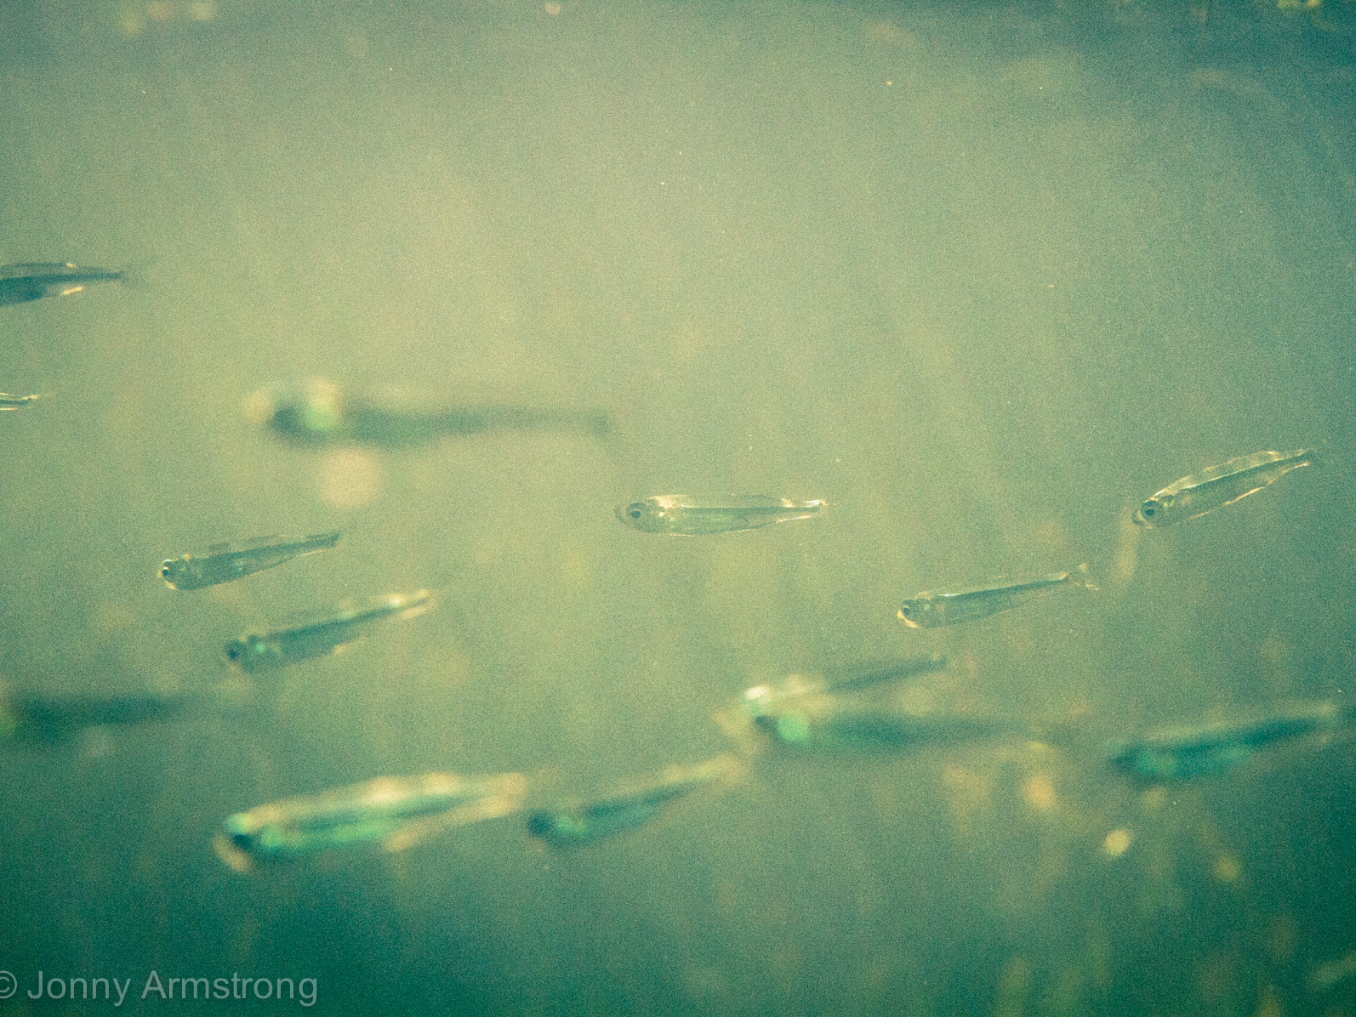
Expressive interface for multivariate spatio-temporal models
Thorson, Anderson, Goddard, Rooper. (2025). tinyVAST: R Package With an Expressive Interface to Specify Lagged and Simultaneous Effects in Multivariate Spatio-Temporal Models. Global Ecology and Biogeography, 34(4), e70035. https://doi.org/10.1111/geb.70035

Slide 2
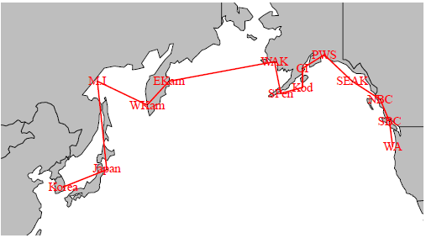
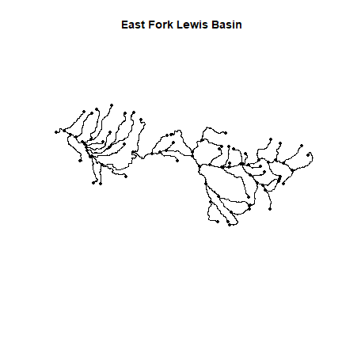
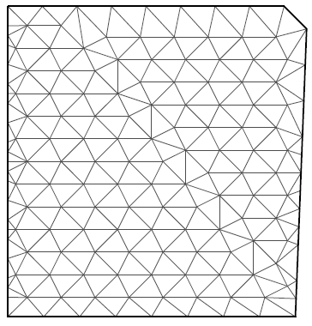
Spatial domains
Domain | Visual example
Adjacency (areal data)
Graph (stream network)
Continuous in 2D (SPDE method from INLA)

Slide 3
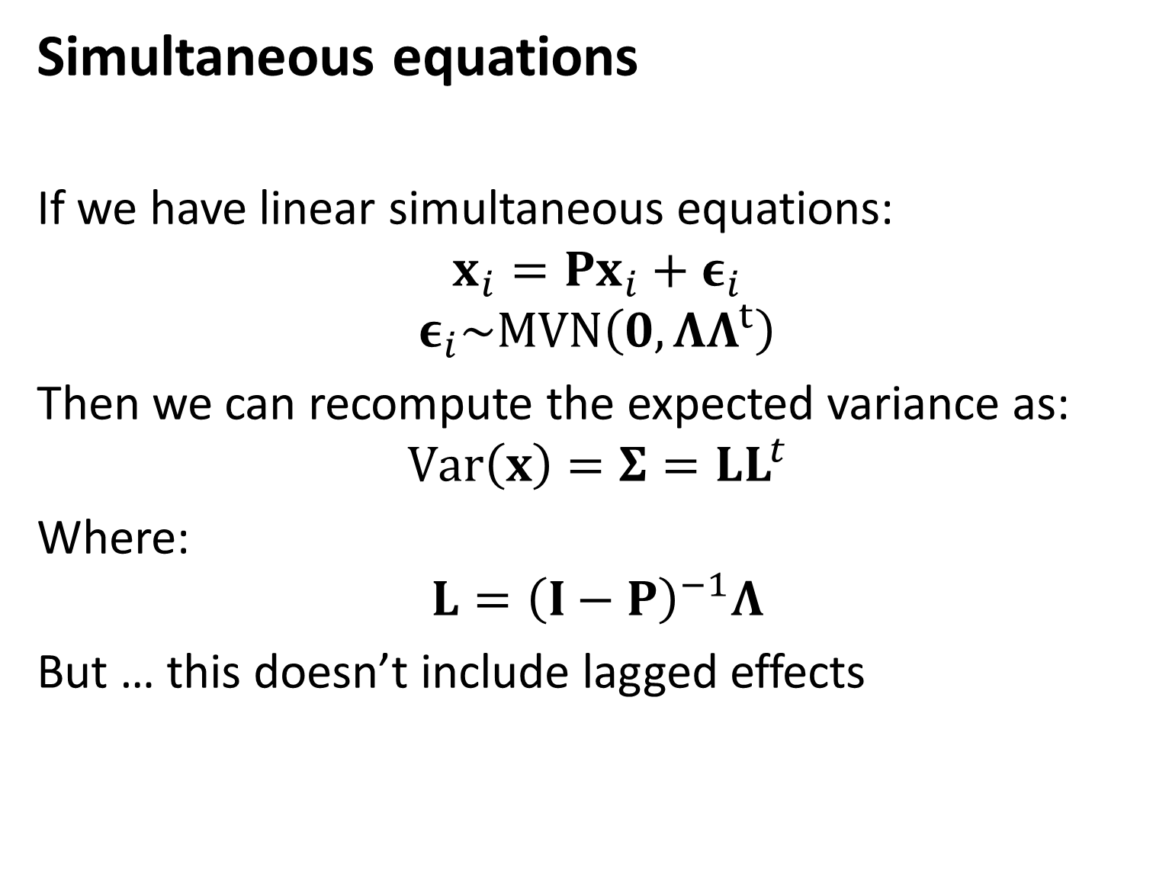
Simultaneous equations
If we have linear simultaneous equations:
$$x_{i}=Px_{i}+ε_{i}$$
$$ε_{i}\sim MVN\left(0,ΛΛ^{t}\right)$$
Then we can recompute the expected variance as:
$$Var\left(x\right)=Σ=LL^{t}$$
Where:
$$L={\left(I−P\right)}^{−1}Λ$$
But … this doesn’t include lagged effects

Slide 4
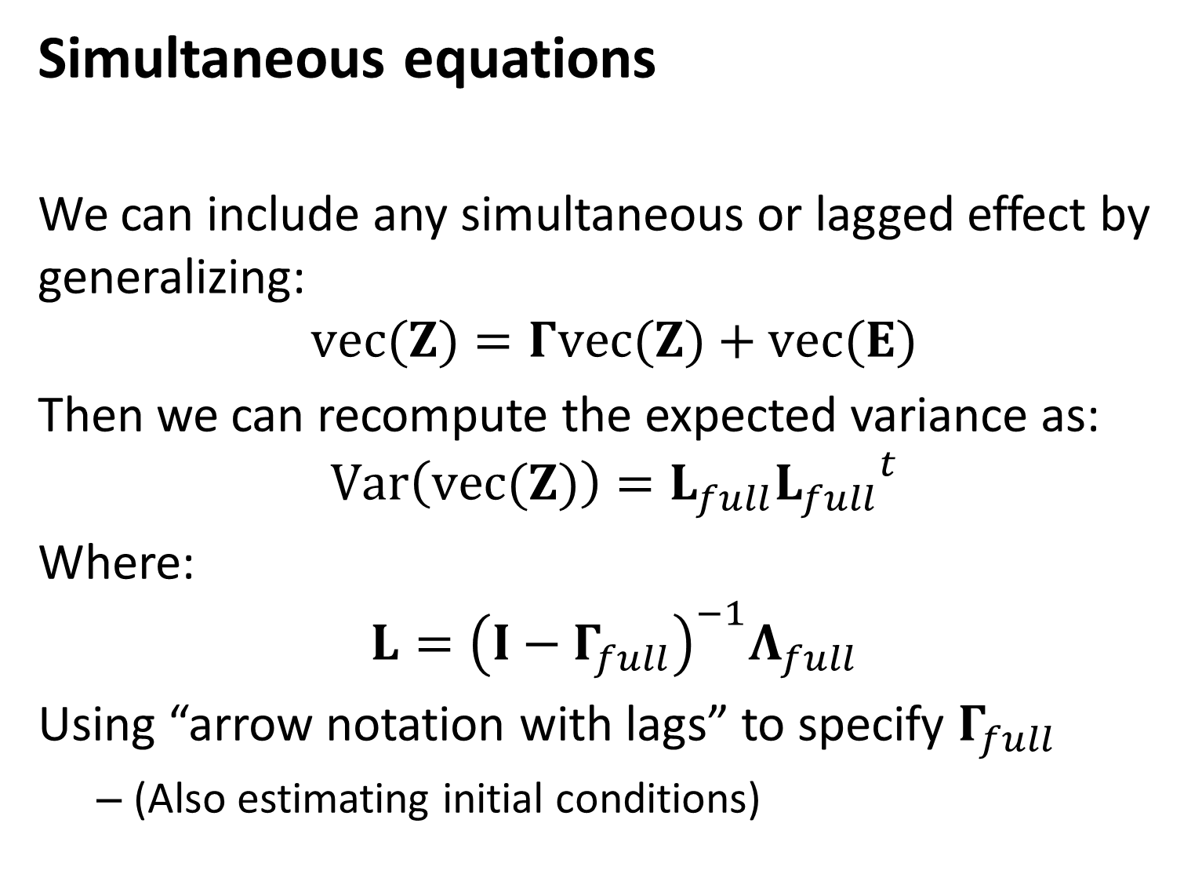
Simultaneous equations
We can include any simultaneous or lagged effect by generalizing:
$$vec(Z)=Γvec(Z)+vec(E)$$
Then we can recompute the expected variance as:
$$Var\left(vec(Z)\right)=L_{full}{L_{full}}^{t}$$
Where:
$$L={\left(I−Γ_{full}\right)}^{−1}Λ_{full}$$
Using “arrow notation with lags” to specify $Γ_{full}$
(Also estimating initial conditions)

Slide 5
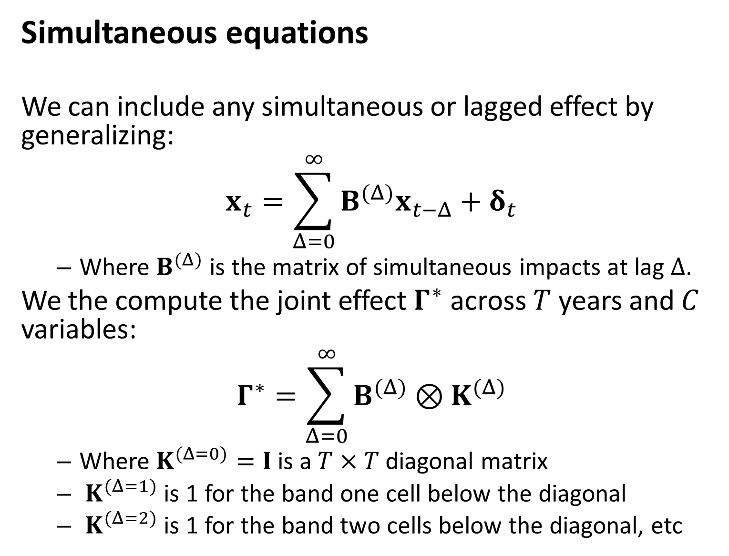
Simultaneous equations
We can include any simultaneous or lagged effect by generalizing:
$$x_{t}=\sum_{Δ=0}^{∞}{B^{(Δ)}x_{t−Δ}}+δ_{t}$$
Where $B^{(Δ)}$ is the matrix of simultaneous impacts at lag $Δ$.
We the compute the joint effect $Γ^{∗}$ across $T$ years and $C$ variables:
$$Γ^{∗}=\sum_{Δ=0}^{∞}{B^{(Δ)}⊗K^{(Δ)}}$$
Where $K^{(Δ=0)}=I$ is a $T×T$ diagonal matrix
$K^{(Δ=1)}$ is 1 for the band one cell below the diagonal
$K^{(Δ=2)}$ is 1 for the band two cells below the diagonal, etc

Slide 6
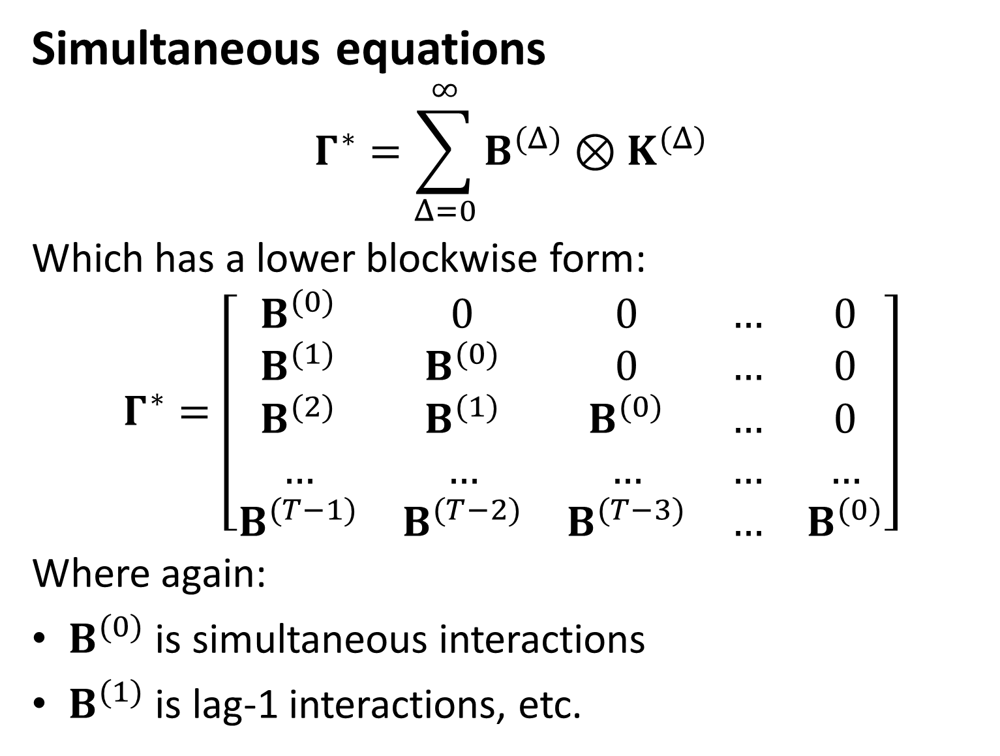
Simultaneous equations
$$Γ^{∗}=\sum_{Δ=0}^{∞}{B^{(Δ)}⊗K^{(Δ)}}$$
Which has a lower blockwise form:
$$Γ^{∗}=\left[\begin{matrix}B^{(0)} & 0 & 0 & … & 0 \\ B^{(1)} & B^{(0)} & 0 & … & 0 \\ B^{(2)} & B^{(1)} & B^{(0)} & … & 0 \\ … & … & … & … & … \\ B^{(T−1)} & B^{(T−2)} & B^{(T−3)} & … & B^{(0)}\end{matrix}\right]$$
Where again:
$B^{(0)}$ is simultaneous interactions
$B^{(1)}$ is lag-1 interactions, etc.

Slide 7
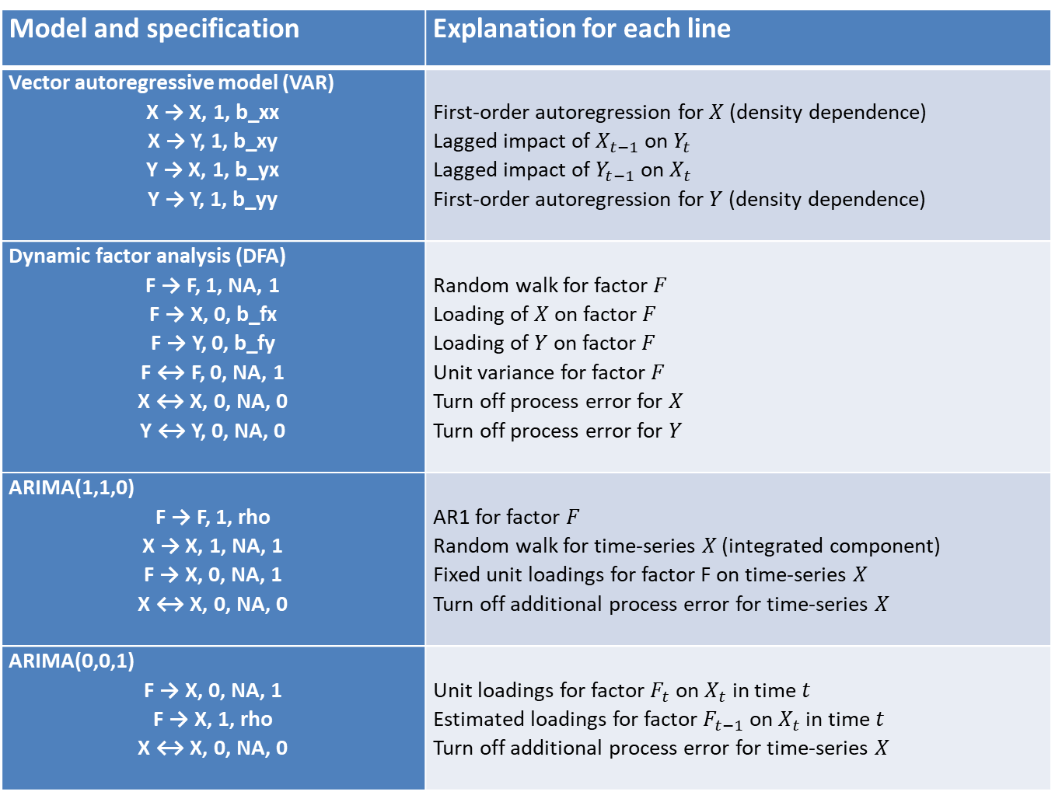
How to use “arrow-and-lag” notation
Model and specification | Explanation for each line
Vector autoregressive model (VAR) X → X, 1, b_xx X → Y, 1, b_xy Y → X, 1, b_yx Y → Y, 1, b_yy | First-order autoregression for $X$ (density dependence) Lagged impact of $X_{t−1}$ on $Y_{t}$ Lagged impact of $Y_{t−1}$ on $X_{t}$ First-order autoregression for $Y$ (density dependence)
Dynamic factor analysis (DFA) F → F, 1, NA, 1 F → X, 0, b_fx F → Y, 0, b_fy F ↔ F, 0, NA, 1 X ↔ X, 0, NA, 0 Y ↔ Y, 0, NA, 0 | Random walk for factor $F$ Loading of $X$ on factor $F$ Loading of $Y$ on factor $F$ Unit variance for factor $F$ Turn off process error for $X$ Turn off process error for $Y$
ARIMA(1,1,0) F → F, 1, rho X → X, 1, NA, 1 F → X, 0, NA, 1 X ↔ X, 0, NA, 0 | AR1 for factor $F$ Random walk for time-series $X$ (integrated component) Fixed unit loadings for factor F on time-series $X$ Turn off additional process error for time-series $X$
ARIMA(0,0,1) F → X, 0, NA, 1 F → X, 1, rho X ↔ X, 0, NA, 0 | Unit loadings for factor $F_{t}$ on $X_{t}$ in time $t$ Estimated loadings for factor $F_{t−1}$ on $X_{t}$ in time $t$ Turn off additional process error for time-series $X$

Slide 8
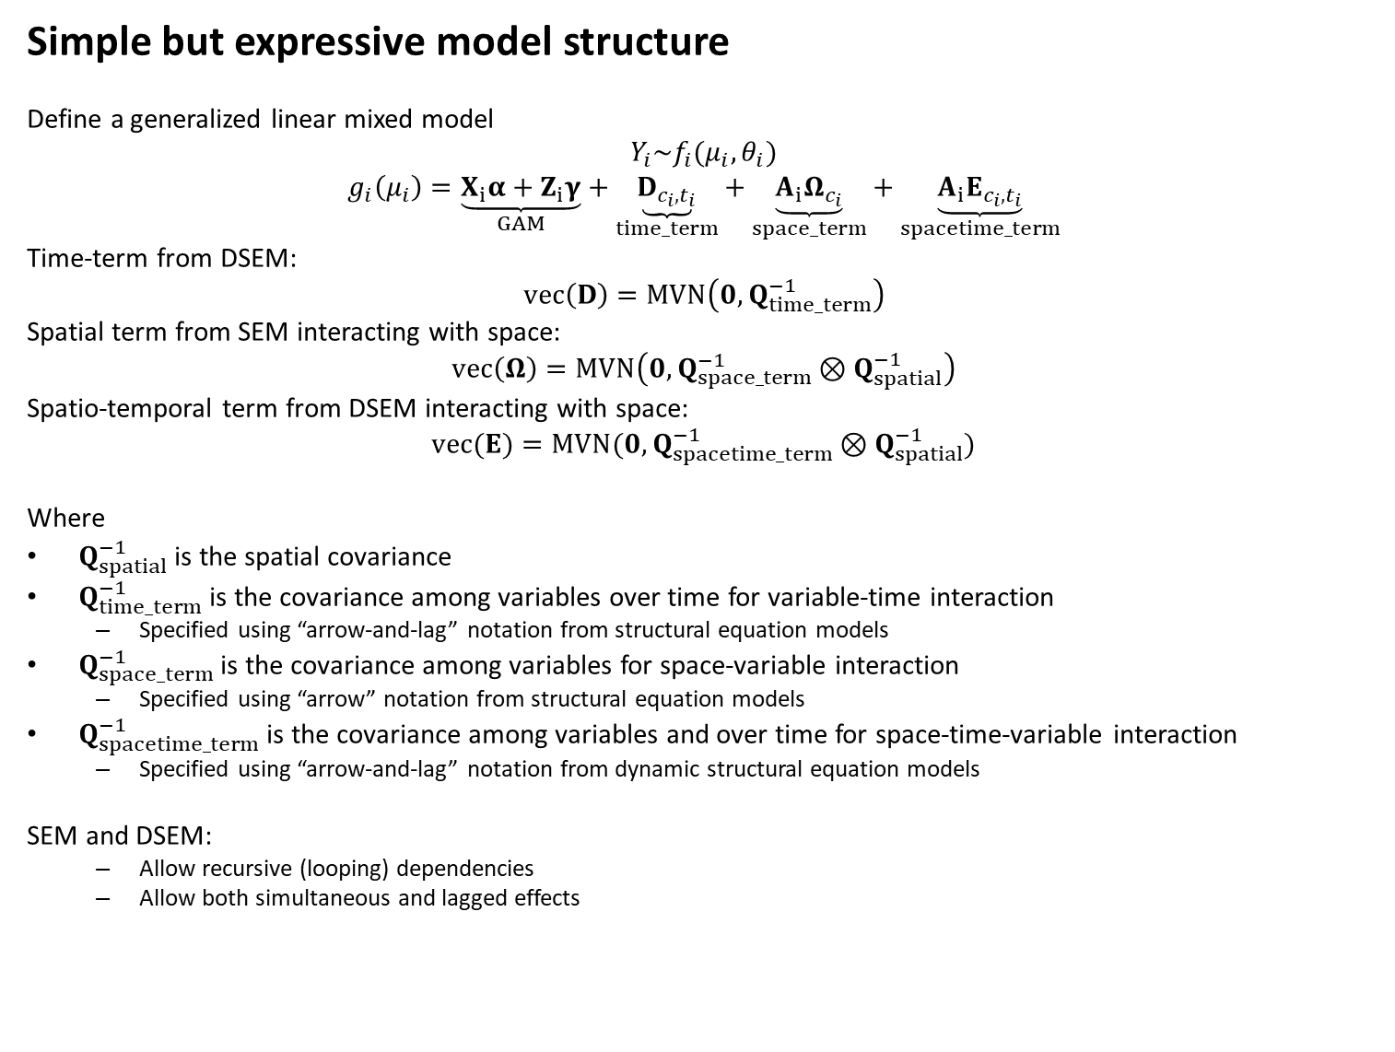
Simple but expressive model structure
Define a generalized linear mixed model
$$Y_{i}\sim f_{i}(μ_{i},θ_{i})$$
$$g_{i}\left(μ_{i}\right)=\underset{GAM}{\underbrace{X_{i}α+Z_{i}γ}}+\underset{time_term}{\underbrace{D_{c_{i},t_{i}}}}+\underset{space_term}{\underbrace{A_{i}Ω_{c_{i}}}}+\underset{spacetime_term}{\underbrace{A_{i}Ε_{c_{i},t_{i}}}}$$
Time-term from DSEM:
$$vec\left(D\right)=MVN\left(0,Q_{time_term}^{−1}\right)$$
Spatial term from SEM interacting with space:
$$vec\left(Ω\right)=MVN\left(0,Q_{space_term}^{−1}⊗Q_{spatial}^{−1}\right)$$
Spatio-temporal term from DSEM interacting with space:
$$vec(Ε)=MVN(0,Q_{spacetime_term}^{−1}⊗Q_{spatial}^{−1})$$
Where
$Q_{spatial}^{−1}$ is the spatial covariance
$Q_{time_term}^{−1}$ is the covariance among variables over time for variable-time interaction
Specified using “arrow-and-lag” notation from structural equation models
$Q_{space_term}^{−1}$ is the covariance among variables for space-variable interaction
Specified using “arrow” notation from structural equation models
$Q_{spacetime_term}^{−1}$ is the covariance among variables and over time for space-time-variable interaction
Specified using “arrow-and-lag” notation from dynamic structural equation models
SEM and DSEM:
Allow recursive (looping) dependencies
Allow both simultaneous and lagged effects

Slide 9
How it compares to other software
 | R-package
Model type | sem | mgcv | dsem | sdmTMB | VAST | tinyVAST
Available on CRAN | X | X | X | X |  | X
No spatial or temporal correlations
Instrumental variables | X |  |  |  |  | X
Time-series correlations
Vector autoregressive model |  |  | X |  |  | X
Dynamic factor analysis |  |  | X |  |  | X
Spatio-temporal correlations
Spatial vector autoregressive model |  |  |  |  | X | X
Empirical orthogonal function analysis |  |  |  |  | X | X
Spatial factor analysis |  |  |  |  | X | X
Univariate species distribution model |  | X |  | X | X | X
Multivariate species distribution model |  | X |  |  | X | X
Smoothing spline response for covariates |  | X |  | X |  | X
Multiple distribution / link functions for different variables |  |  |  |  | X | X

Slide 10
Available demos
Vignette | What it demonstrates
Dynamic structural equation models | Fitting dynamic structural equation models (DSEM) to time-series
Comparison with mgcv | Specifying a generalized additive models (GAMs)
Empirical orthogonal function analysis | Specifying an empirical orthogonal function (EOF) model
Simultaneous autoregressive process | Specifying a simultaneous autoregressive (SAR) model
Spatial modeling | Specifying a spatial model in two-dimensional coordinates
Spatial factor analysis | Specifying a spatial factor analysis (SFA) model that estimates covariance among multiple variables
Stream network models | Specifying a spatial model on a stream network
Vector autoregressive spatio-temporal models | Specifying a univariate and bivariate vector-autoregressive spatio-temporal model
Multiple data types | Specifying an integrated species distribution model using presence/absence, count, and biomass sampling data
Age composition analysis | Specifying a multivariate SDM involving multiple ages
Condition and density | Specifying a marked point process involving numerical density and physiological condition

Slide 11
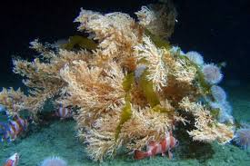
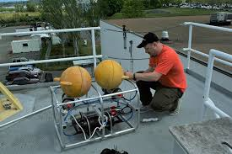
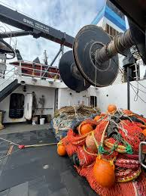
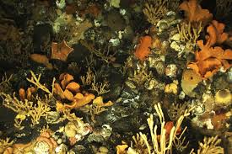
Habitat associations
Goal:
Estimate distribution and habitat associations for fishes, corals, and sponges using two different monitoring programs

Slide 12
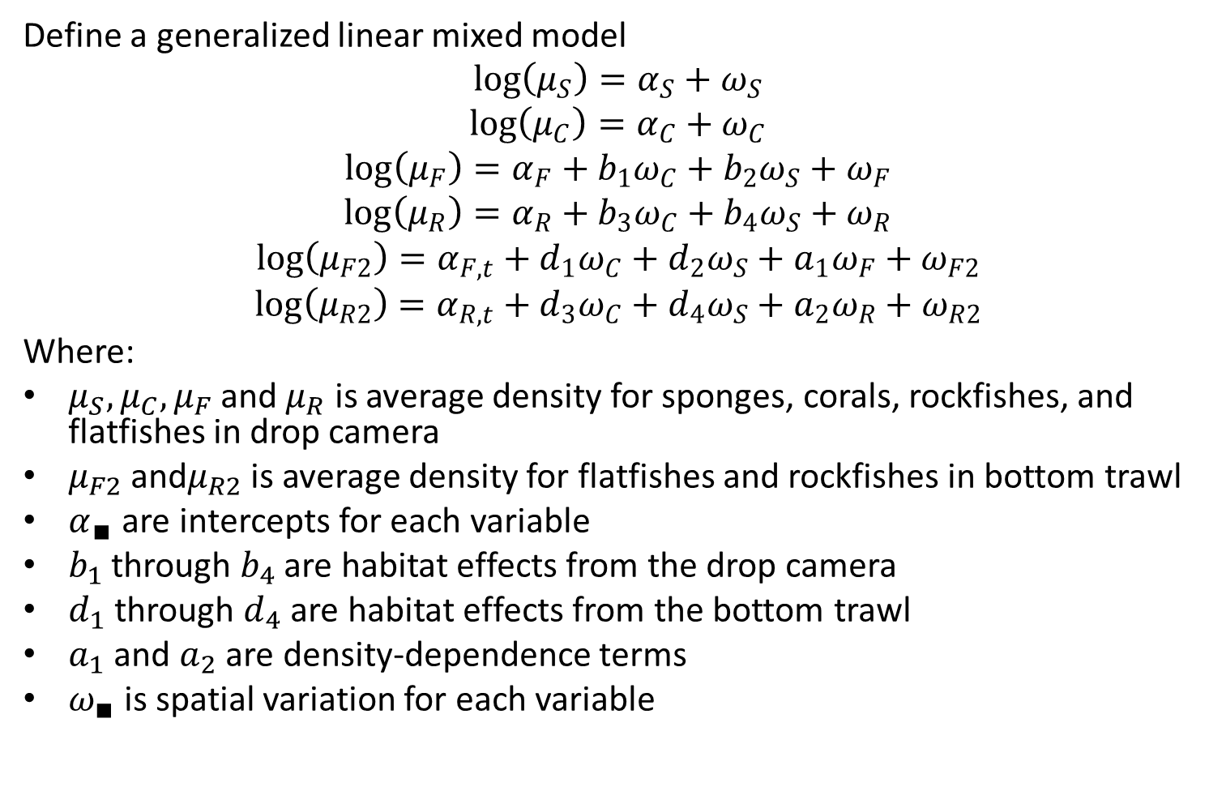
Habitat associations
Define a generalized linear mixed model
$$\log\left(μ_{S}\right)=α_{S}+ω_{S}$$
$$\log\left(μ_{C}\right)=α_{C}+ω_{C}$$
$$\log\left(μ_{F}\right)=α_{F}+b_{1}ω_{C}+b_{2}ω_{S}+ω_{F}$$
$$\log\left(μ_{R}\right)=α_{R}+b_{3}ω_{C}+b_{4}ω_{S}+ω_{R}$$
$$\log\left(μ_{F2}\right)=α_{F,t}+d_{1}ω_{C}+d_{2}ω_{S}+a_{1}ω_{F}+ω_{F2}$$
$$\log\left(μ_{R2}\right)=α_{R,t}+d_{3}ω_{C}+d_{4}ω_{S}+a_{2}ω_{R}+ω_{R2}$$
Where:
$μ_{S}, μ_{C}, μ_{F}$ and$μ_{R}$ is average density for sponges, corals, rockfishes, and flatfishes in drop camera
$μ_{F2}$and$μ_{R2}$ is average density for flatfishes and rockfishes in bottom trawl
$α_{∎}$ are intercepts for each variable
$b_{1}$ through $b_{4}$ are habitat effects from the drop camera
$d_{1}$ through $d_{4}$ are habitat effects from the bottom trawl
$a_{1}$ and $a_{2}$ are density-dependence terms
$ω_{∎}$ is spatial variation for each variable

Slide 13
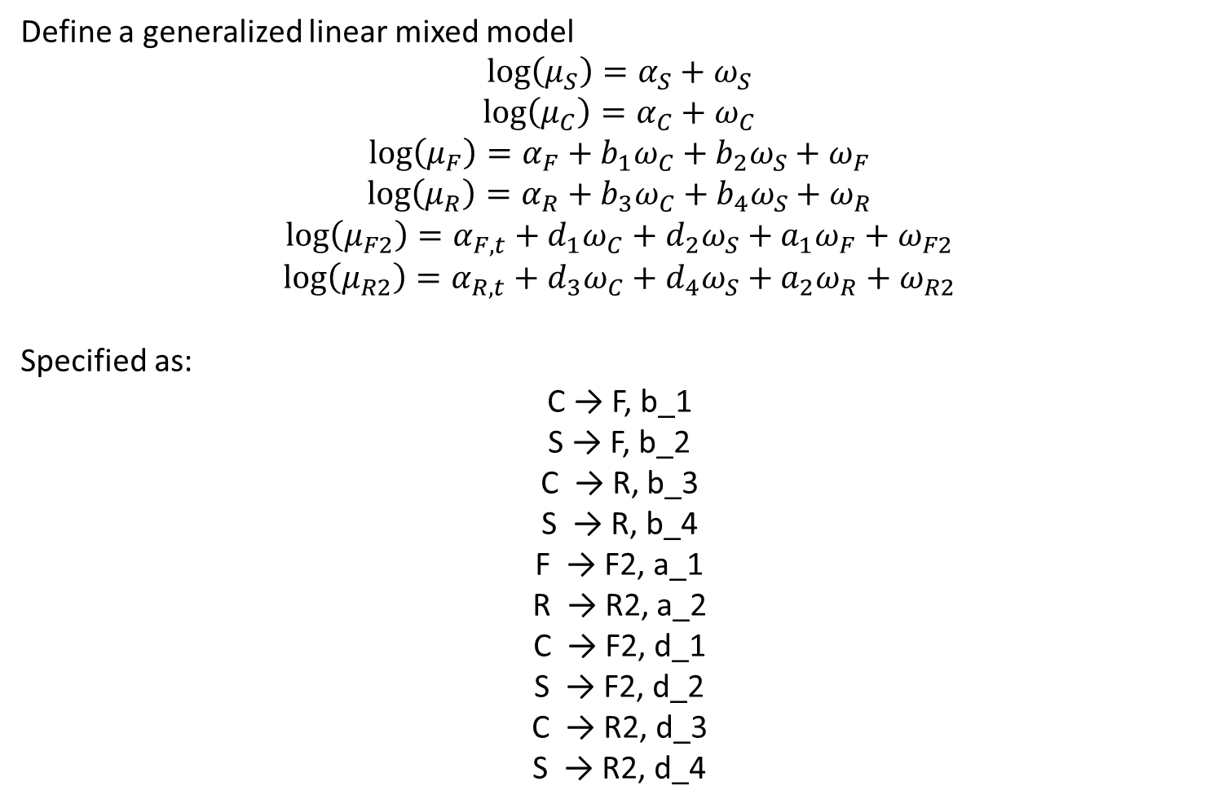
Habitat associations
Define a generalized linear mixed model
$$\log\left(μ_{S}\right)=α_{S}+ω_{S}$$
$$\log\left(μ_{C}\right)=α_{C}+ω_{C}$$
$$\log\left(μ_{F}\right)=α_{F}+b_{1}ω_{C}+b_{2}ω_{S}+ω_{F}$$
$$\log\left(μ_{R}\right)=α_{R}+b_{3}ω_{C}+b_{4}ω_{S}+ω_{R}$$
$$\log\left(μ_{F2}\right)=α_{F,t}+d_{1}ω_{C}+d_{2}ω_{S}+a_{1}ω_{F}+ω_{F2}$$
$$\log\left(μ_{R2}\right)=α_{R,t}+d_{3}ω_{C}+d_{4}ω_{S}+a_{2}ω_{R}+ω_{R2}$$
Specified as:
C → F, b_1
S → F, b_2
C → R, b_3
S → R, b_4
F → F2, a_1
R → R2, a_2
C → F2, d_1
S → F2, d_2
C → R2, d_3
S → R2, d_4

Slide 14
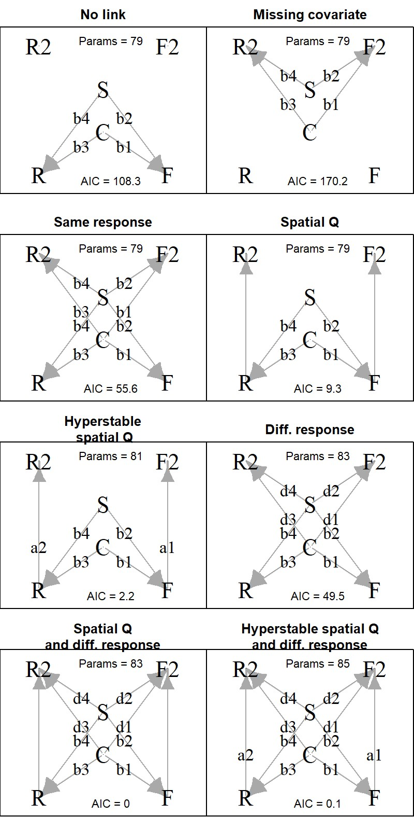
Habitat associations
C: Coral in drop camera
S: Sponge in drop camera
R: Rockfish in drop camera
F: Flatfish in drop camera
R2: Rockfish in bottom trawl
F2: Flatfish in bottom trawl
Different conceptual models

Slide 15
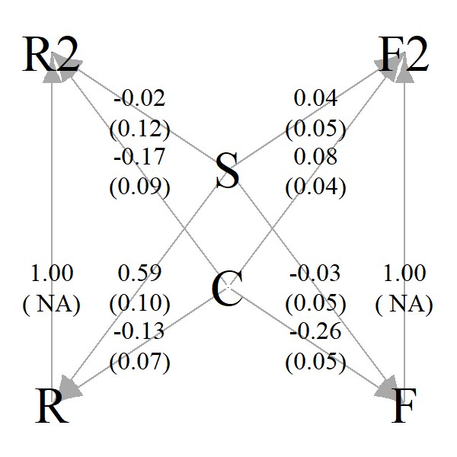
Results
+Sponges → +Rockfish
+Corals → -Flatfish
Associations are similar between drop camera and bottom trawl
Fish densities are proportional in drop camera and bottom trawl

Slide 16
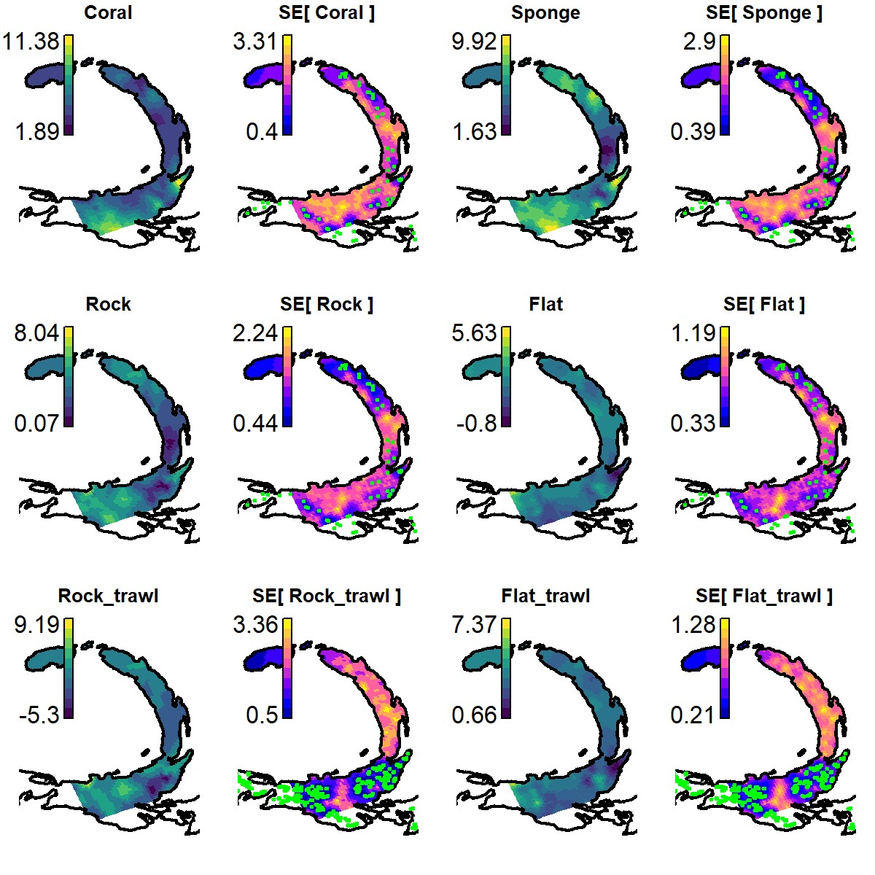
Results
Can estimate “bottom-trawl equivalent” fish where bottom trawl doesn’t occur

